Slide 1
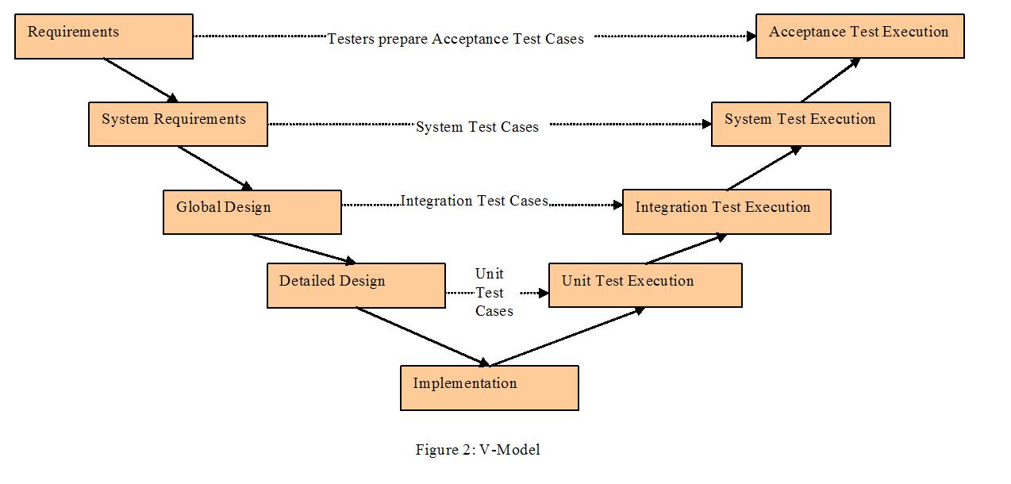
5. Software Test Documentation
Test model:
Source: http://swtmentorsite.appspot.com/sdlc/vmodel.php

Slide 2
5. Software Test Documentation
Test process:
Planning & preparation
Execution
Test report
Requirement analysis

Slide 3
5. Software Test Documentation
Tools:
Purpose | Tool | Vendor/In-house | Version
Defect tracking | MS Word, Excel | Microsoft | 2010
Testing Effort tracking | Microsoft Project | Microsoft | 2010
Documentation writing | MS Word, Excel | Microsoft | 2010
Performance Testing | YSlow | Yahoo! Inc
Database | SQL Server | Microsoft
Project information tracking | TortoiseSVN

Slide 4
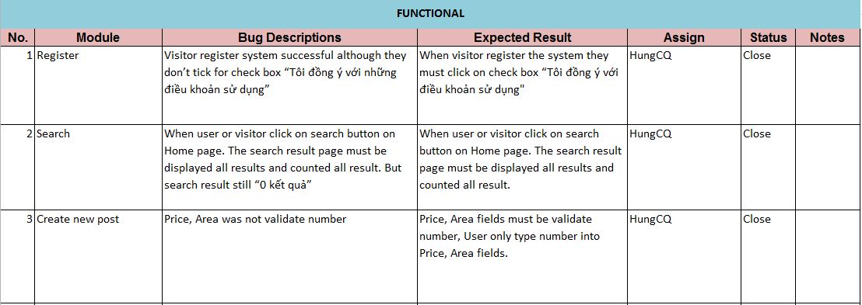
5. Software Test Documentation
Defect log sample

Slide 5
5. Software Test Documentation
Test Report
Number of test cases: 310
Number of passed cases: 310
Number of failed cases: 18 (fixed all)
Number of not tested cases: 0

